Slide 1
Introduction
Developer Tools

Slide 3
How to View This Presentation
To switch to Notes Page view:
While in edit mode, click the View tab within the ribbon, and then click Notes Page
To navigate through notes, use the Page Up and Page Down keys
Zoom in or zoom out, if required
In the Notes Page view, you can:
Read any supporting text—now or after the delivery
Add notes to your copy of the presentation, if required
Take the presentation files home with you

Slide 4
Overview
In this Lesson
Introduction to tools for SharePoint Development
Load Testing
Azure Hosting
Microsoft Office
Visual Studio
SharePoint Designer

Slide 5
Objectives
Discover the various ways to do SharePoint development
Find out how Azure DevOps can aid in your development lifecycle
Understand why Load Testing is important

Slide 6




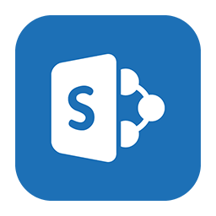
Developer Tools
Microsoft Office
Visio, Access, InfoPath, Excel
Visual Studio 2013, 2015, 2017 and 2019
Visual Studio Code
Microsoft Azure
SharePoint Designer 2013
Notes:
Developers can use a wide variety of tools to interact with SharePoint. In the next lessons we’ll dive into each of these tools. We’ll start with Visual Studio.

Slide 7
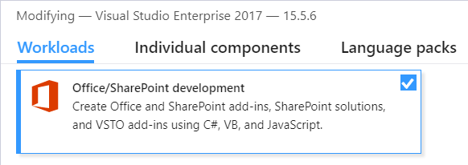
Visual Studio 2013/15/17/19
Office Developer Tools
2013: Installed by default
Install the latest VS Update to utilize the latest templates for SharePoint Add-in development
2015: In the product, but not installed by default
Available in Community, Professional and Enterprise editions
Install the latest VS Update to utilize the latest templates for SharePoint Add-in development
Requires installing a custom tool to add support for SharePoint 2016 in the wizard
2017: In the product, but not installed by default
Check the Office/SharePoint development component
v15.9.0 adds SharePoint 2019 support
2019: same as 2017
Notes:
To develop SharePoint Add-Ins, Visual Studio needs to be equipped with the Microsoft Office Developer Tools. With Visual Studio 2013 these are included in the default installation already. In Visual Studio 2015, in all available editions, it is an optional choice during the installation to install them as shown on the screenshot. Even when doing this, you still need to install an update to the developer tools manually to get support for SharePoint 2016 to be visible in the wizard by installing the update from https://www.microsoft.com/en-us/download/details.aspx?id=51683. Without installing this update, the wizard will detect SharePoint 2016 as SharePoint Online and things will still work fine. For Visual Studio 2017 and 2019, you just install the optional workload “Office/SharePoint development” and you will get full support for creating add-ins. Tools for developing using the SharePoint Framework are a completely different story and will be discussed in the module on the SharePoint Framework.

Slide 8
Visual Studio 2013, 2015, 2017 & 2019
What’s new
New templates
New designer
SharePoint testing\profiling tools support
Support for JS debugging and JS IntelliSense
Stream lined project items
Notes:
The SharePoint developer tools in Visual Studio 2013 & 2015 contain new designers and templates to facilitate SharePoint development, as well as new options for deploying and testing SharePoint sites. See the following descriptions to learn about these and other new features.
This topic contains the following sections:
Create Lists and Content Types by Using New Designers
Create Site Columns
Create Silverlight Web Parts
Publish SharePoint Solutions to Remote SharePoint Servers
Test SharePoint Performance by Using Profiling Tools (Requires Visual Studio Update 1 is mandatory, Update 2 offer additional features)
Create Sandboxed Visual Web Parts
Improved Support for Sandboxed Solutions
Support for JavaScript Debugging and IntelliSense for JavaScript
Streamlined SharePoint Project Templates
Test Your Code by Using Microsoft Fakes Framework
More info: http://msdn.microsoft.com/en-us/library/ee290856(v=vs.110).aspx

Slide 9
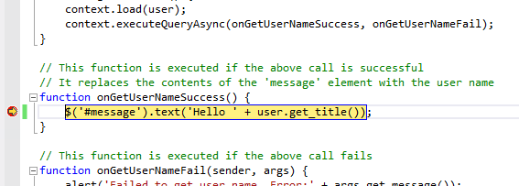
Visual Studio 2013, 2015, 2017 & 2019
Support for JavaScript debugging
Debug JavaScript in the same way you’re used to doing with Full Trust Code solutions

Slide 10
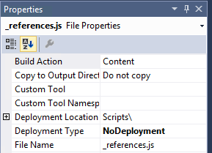
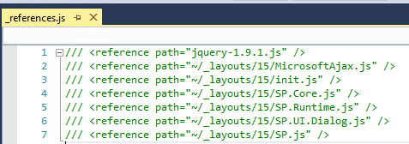
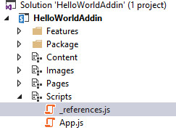
Visual Studio 2013, 2015, 2017 & 2019
Support for JavaScript IntelliSense
IntelliSense provided for JavaScript in the same way as with Full Trust Code Solutions
Works by adding references to JavaScript files in a file called _references.js placed inside a folder called Scripts in the root of your project
Notes:
Alternatively, the references can also be placed at the top of an individual JS file to have it only apply to that JS file. By placing it in the _references.js file inside the Scripts folder, it applies to all JS files within the same project.

Slide 11

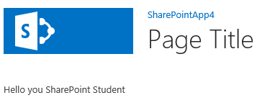
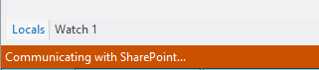
Visual Studio 2013, 2015, 2017 & 2019
Modifying files – SharePoint Hosted Add-Ins
Allows on the fly editing of JavaScript with SharePoint Hosted Add-Ins
Edit JavaScript in Visual Studio
Save the JavaScript file
Visual Studio automatically uploads the new JavaScript
Refresh your browser to directly see the update
Notes:
A cool new feature in Visual Studio is that when you modify files in Visual Studio when creating a SharePoint Hosted Add-In, when saving your files, Visual Studio will automatically upload your changes to the App Web. This allows for super fast development where you can spent your time on creating functionality instead of waiting for deployments or recycles as was the case with Full Trust Code or Sandboxed Solutions in the past.

Slide 12
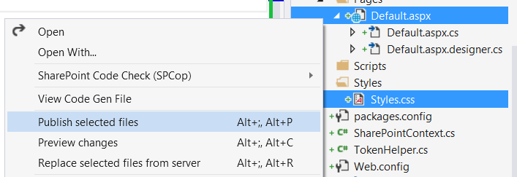
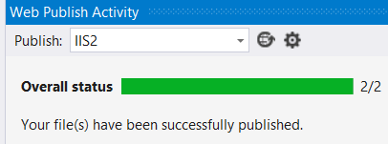
Visual Studio 2013, 2015, 2017 & 2019
Modifying files – Provider Hosted Add-Ins
Allows on the fly publishing files of Provider Hosted Add-Ins
Set up the Publishing Profile
Right click on the file(s) to update and select Publish
Fast and easy, no need to redeploy the whole site
Notes:
When using Provider Hosted Add-Ins you have something similar to your disposal. It works slightly different though. Instead of just having to save your changes, you manually need to instruct Visual Studio to publish your file(s). It’s still lightning fast compared to traditional SharePoint customization procedures.

Slide 13
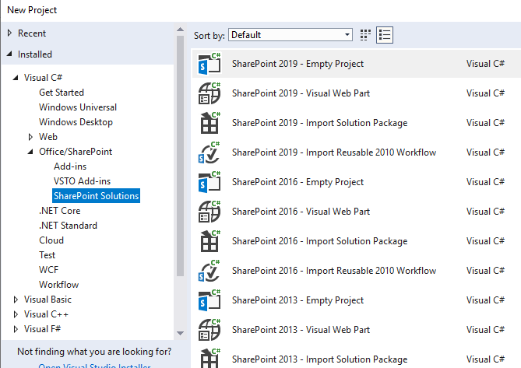
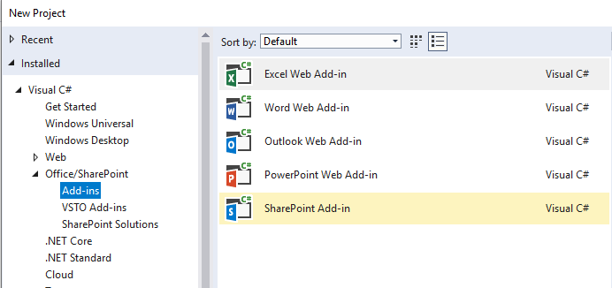
SharePoint Project Templates
Visual Studio project templates for different SharePoint Projects
Add-In Development for SharePoint 2013, 2016 & 2019
Classic Solution development for SharePoint 2013, 2016 & 2019
Notes:
Visual Studio has templates for four types of SharePoint projects

Slide 14
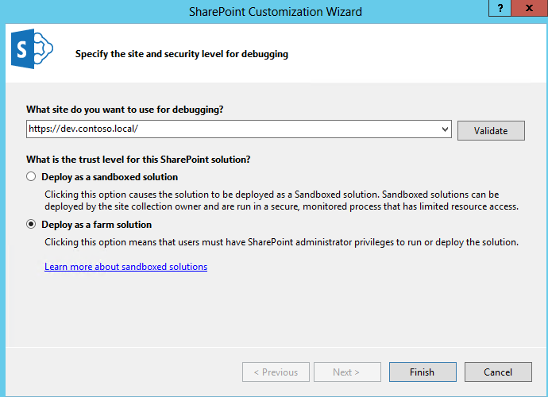
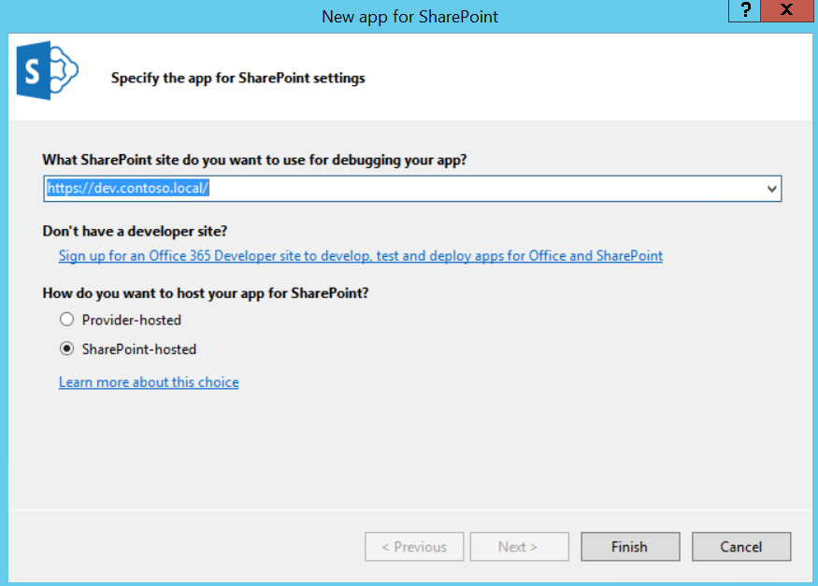
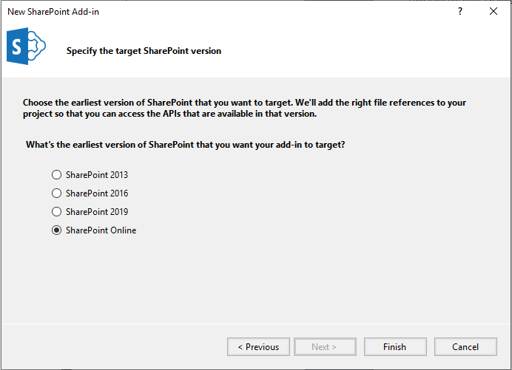
SharePoint Projects
Notes:
When creating a SharePoint solution, you will create a new project from one of the many project templates dedicated to solutions development. When you create a new project for a SharePoint solution, Visual Studio will prompt you to select Deploy as a sandboxed solution or Deploy as a farm solution. Remember that your choice can be changed after the project has been created by changing a project property.

Slide 15
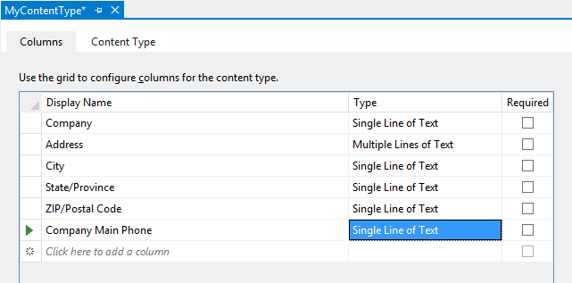
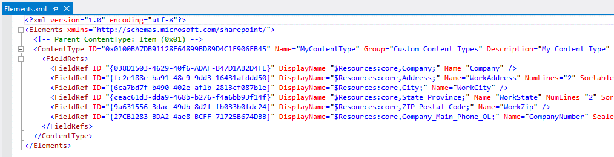
Designers
Lists
Content Types
Views
Notes:
Visual Studio 2015 has designers for lists, content types and views. Previously when creating either of these, you still had to fiddle with XML files yourself to get it done. Since it involved many identifiers and required them to match everywhere, it was easy to make mistakes with it which would lead to weird results. With the visual designers being available, this task becomes a lot less tedious.
Visual Studio 2015 carries on the new features from VS 2013 for SharePoint development. This includes project item templates to create site columns and to create custom list definitions using a new visual designer. The list designer makes it possible to create new lists either with or without the use of explicit content types. The best part about the visual designer is that it is able to edit the files for a list definition such as the elements.xml file and the schema.xml file behind the scenes.
Project Items to create Custom List Schema
Site column used to create reusable column definition
Content type defines columns for list or document library
Visual Studio provides new Content Type Editor
Elements.xml automatically edited behind scenes

Slide 16
Visual Studio 2013, 2015, 2017 & 2019
Solution Deployment
Solutions are deployed using Solution Packages
Solution package is CAB file with .wsp extension
Solution package contains manifest.xml file
Solution package optionally contains declarative elements
Solution package optionally contains DLL with server-side code
Solution packages can be deployed two ways
Farms solutions deployed at farm scope
Sandboxed solutions deployed at site collection scope
Add-In Deployment will be discussed in a later module
Notes:
Just as in SharePoint 2010, SharePoint Solutions are deployed using a special type of CAB file with a file extension of .wsp known as a Solution Package. A solution package is a container that always holds a manifest file with the well-known name of manifest.xml.
A solution package can optionally contain declarative elements to create site elements such as pages, lists and navigation items. In case where a SharePoint solution contains server-side code written in C# or VB.NET, a solution package contains an assembly DLL.
A solution packages can be deployed one of two different ways:
Farms solutions deployed at farm scope and provide the most power to developers
Sandboxed solutions deployed as site collection scope and can be deployed up to sites within Office 365

Slide 17
Fixing Ghosted Files
ReplaceContent attribute allows unghosted/customized files to be overwritten
Notes:
We introduced a new attribute to the file element in SharePoint 2013 that allows a developer to overwrite existing ghostable files in SharePoint libraries. The attribute is ReplaceContent="True". If you set that attribute to True SharePoint will replace your file if it already exists.
For more info: http://blogs.msdn.com/b/how24/archive/2013/06/14/overwriting-ghostable-files-in-sharepoint-2013-libraries-using-feature-elements.aspx
https://msdn.microsoft.com/en-us/library/office/ms459213(v=office.15).aspx

Slide 18

Developer Tools
Microsoft Office
Visio, Access, InfoPath, Excel
Visual Studio 2013, 2015, 2017 and 2019
Visual Studio Code
Microsoft Azure
SharePoint Designer 2013
Notes:
Next up is Visual Studio Code

Slide 19

Visual Studio Code
Open Source – entirely free
Cross platform on Windows, Linux and macOS
Lightweight
Extensible
Notes:
Visual Studio Code exists since April 29, 2015 and has since become an important player in tools for developing software. Due to it being completely open source and free, it has gained a lot of popularity. It works across platforms on Windows, Linux and macOS operating systems. It’s much more lightweight and faster than Visual Studio 201x is. There are a lot of extensions available to aid in software development thought the built in marketplace.

Slide 20
Developer Tools
Microsoft Office
Visio, Access, InfoPath, Excel
Visual Studio 2013, 2015, 2017 and 2019
Visual Studio Code
Microsoft Azure
SharePoint Designer 2013
Notes:
Next up is SharePoint Designer 2013

Slide 21
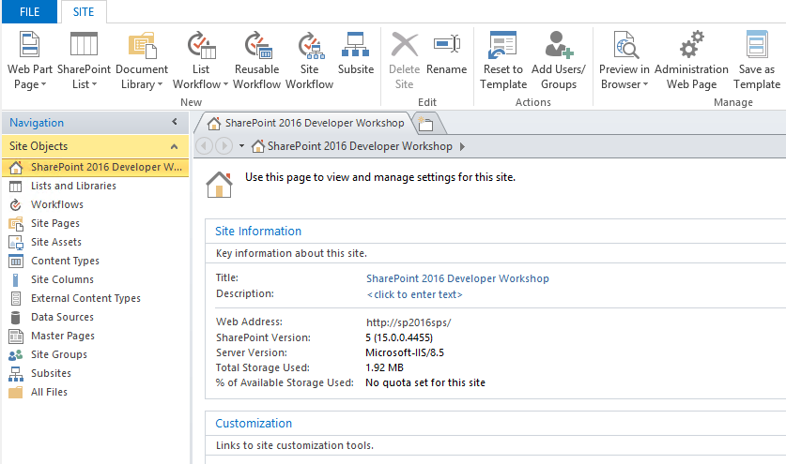
What can it be used for
Create custom workflows
Customize layout pages (classic only)
Customize pages (classic only)
Preview and split modes are no longer available (just code view)
Build list views
Connect Web Parts
All is directly done on the content database
Access can be disabled in Central Administration
SharePoint Designer
Notes:
This slide details the typical things you would still use SharePoint Designer for
Here you see what SharePoint Designer 2013 looks like. In the left column you see a variety of options. In the right panel you can see detailed information for what you selected. Notice that SharePoint Designer also makes use of the Ribbon concept as we see throughout Office products and SharePoint.

Slide 22
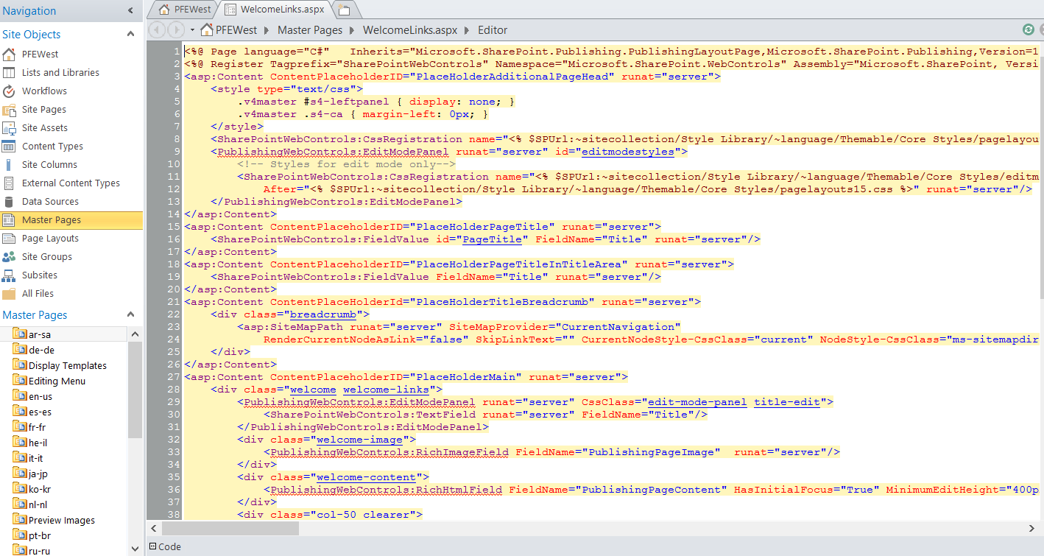
SharePoint Designer 2013
Code View
SharePoint Designer
Notes:
Design view and Split view
No more design view and split view, only code view
Supports data view
Description of the change. SharePoint Designer 2010 has three views for editing HTML and ASPX pages: Code view, Design view, and Split view. Design view and Split view are removed from SharePoint Designer 2013. The removal of Design view and Split view affects the features of SharePoint Designer 2013 that are used for editing Web Parts and master pages. If you edit pages in SharePoint Designer 2013, you must use Code view.
The reason for the change. Compared to current versions of Internet Explorer, Design view is an older technology that does not support many new HTML5 and CSS tags.
Migration path. If you edit pages in Code view, you can press F12 to preview the page in the browser. Alternatively, you can use Visual Studio to edit pages.
If you want to visually design or brand your site, and you want a WYSIWYG ("what you see is what you get") page-editing experience, you can use any professional HTML editor, such as Microsoft Visual Studio. Then you can import your HTML files into SharePoint Server 2013 by using the new Design Manager, which is a feature included in publishing sites, such as the Publishing Portal Site Collection site template.

Slide 23
Future of SharePoint Designer
SharePoint Designer 2013 will not be evolved
Support ends on July 14th, 2026
No alternatives for purely on premises SharePoint 2010 and 2013 based workflows
If hybrid is an option, consider On-Premises Data Gateway for Microsoft Power Automate
Other operations could be done via the web UI and (PnP) PowerShell
SharePoint Designer
Notes:
No new SharePoint Designer version will be released anymore. The current 2013 version will be the last version and will remain in support until July 14th, 2016. There is no alternative for creating SharePoint 2010 and 2013 workflows, which are the only options if you want to stay purely on-premises. If a hybrid setup is an option, it is recommended to install the On-Premises Data Gateway for Flow and have your workflows run in Microsoft Flow in Office 365 and let them access your SharePoint farm on-premises through the gateway.
More information on the On-Premises Data Gateway for Flow:
https://docs.microsoft.com/en-us/flow/gateway-reference
Most other options can also be done through the WebUI, PowerShell or PnP PowerShell.

Slide 24
Demo
Using SharePoint Designer
Notes:
Show how SharePoint Designer works

Slide 25
Knowledge Check
Is it possible to disable the use of SharePoint Designer?
Yes
Will there be a new version of SharePoint Designer 2013?
No
Notes:
How to disable SharePoint Designer:
https://support.microsoft.com/en-ie/help/2592376/manage-permissions-and-control-access-to-sharepoint-designer
Microsoft will not create any version of SharePoint Designer after the currently latest available 2013 version anymore.

Slide 26
Developer Tools
Microsoft Office
Visio, Access, InfoPath, Excel
Visual Studio 2013, 2015, 2017 and 2019
Visual Studio Code
Microsoft Azure
SharePoint Designer 2013
Notes:
Next up is Microsoft Office

Slide 27
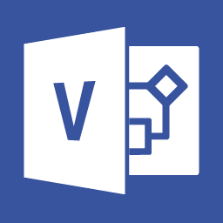
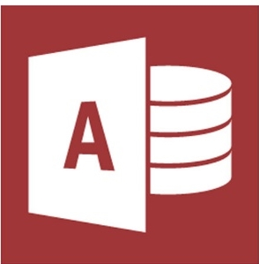
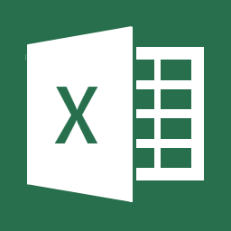
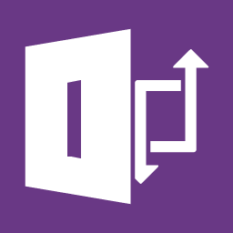
Enhance with Microsoft Office
Create workflows designed with Visio
Render diagrams using Visio Services
Microsoft Office
Create browser ready Add-Ins for SharePoint designed with Microsoft Access 2013/2016
Removed from SPO Deprecated in 2019
Display workbooks in the browser using Excel Services
Create dashboards and reports using BI features for Excel
Create forms deployed for SharePoint
Publish forms designs with InfoPath that renders in the browser
Deprecated
In 2026 out of support
Notes:
In the Office suite we find a variety of products that we can use to customize SharePoint. This slide gives you an overview of four of the products which you can use and what you can use it for in relationship with SharePoint 2019. Note that InfoPath is announced deprecated. More on this later on. The next slides will go into further detail on these products.

Slide 28
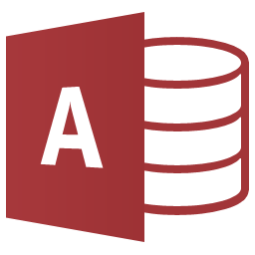
Access
Design data driven applications through the familiar interface of Access
Suitable for end users
Creates a SQL database on the backend
Can be SQL Azure or on premises SQL Server
Can even pull in data from SharePoint Lists
Leverage SQL Server reporting tools
Create Access forms (InfoPath alternative) and reports
Only for SharePoint 2013, 2016 and 2019 On Premises
Microsoft Office
Notes:
For more information, see http://msdn.microsoft.com/en-us/library/office/jj249372
It is even possible to pull in data from SharePoint Lists into an Access Add-In:
http://blogs.office.com/2012/08/30/connect-your-access-2013-web-apps-to-sharepoint-lists/
Notice that Microsoft Access Add-Ins are only possible on on premises SharePoint 2013 and SharePoint 2016 farms that have explicitly been configured to support Microsoft Access Add-Ins. Microsoft Access Add-Ins will be retired from SharePoint Online in the near future.
When starting Access 2016, you’ll see the templates “Custom web app” and “Blank database”. The first is the one you select to create Access 2016 Add-Ins hosted within SharePoint 2016 or on SharePoint Online.

Slide 29

InfoPath
Announced to be discontinued on January 31st, 2014
The InfoPath 2013 client (when used with SharePoint) will be supported through July 2026
InfoPath Forms Services for SharePoint Server 2016 will be supported until July 2026
InfoPath Forms Services in Office 365 will be supported until further notice
Office 2016 will not contain InfoPath, InfoPath 2013 can be installed alongside using special installer
Successors in Office 365 are the Power Platform and Microsoft Forms
Microsoft Office
Notes:
InfoPath can be used to customize forms. It has been announced deprecated in 2014 and will stay supported until July 2026.
If installing InfoPath 2013 next to Office 365 Pro Plus on your machine, be sure to install InfoPath 2013 from https://go.microsoft.com/fwlink/?linkid=828596 and NOT from the Office 2013 installation as it will mess up things.
The official announcement can be found at:
https://blogs.office.com/2014/01/31/update-on-infopath-and-sharepoint-forms/
Mainstream Support End Date - 7/13/2021
Extended Support End Date - 7/14/2026
The successor for InfoPath in an Office 365 are in the Power Platform: Power Automate, Power Apps and Power BI. Also Microsoft Forms could fit some of the cases where you would use InfoPath before. For on premises, no successor has been identified yet. At one point Microsoft Access Add-Ins was a potential candidate for it, but it only exists in SharePoint 2013 and 2016 and has been removed in SharePoint 2019 and SharePoint Online, so not the best one to invest in anymore either.

Slide 30
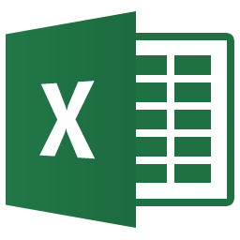
Excel
Synchronize data with SharePoint
Create dashboards
Microsoft BI tool for excellence leveraging PowerPivot + PowerView (requires SQL Server 2016 CTP 3.1), PowerMap and PowerQuery
Create graphs
Analyze information
Microsoft Office
Notes:
Excel 2016 offers certain business intelligence capabilities that make it easier than ever to explore and analyze data. Many of these features are supported by Excel Services (now part of Excel Online in Office Online Server). - https://technet.microsoft.com/en-us/library/jj219698(v=office.16).aspx
Using Excel 2016, you can create powerful reports, scorecards, and dashboards. You can bring data into Excel, sort, and organize data, and use it to create reports and scorecards. You can also use powerful analytic capabilities in Excel to visualize and explore data.
After you have created reports, scorecards, and dashboards using Excel, you can publish those items to Excel Online in Office Online Server and use them in SharePoint to make them available to people in your organization.
Excel Services and its associated business intelligence capabilities are no longer hosted on SharePoint Server. Excel Services functionality is now part of Excel Online in Office Online Server (this is the next version of Office Web Apps Server), and SharePoint users can use the services from there. For more information, see Office Online Server now available, Office Online Server, and Configure Excel Online administrative settings.
If you currently use Excel Services in SharePoint 2013 and upgrade to SharePoint Server 2016 you must also deploy Office Online Server with Excel Online to ensure Excel Services functionality remains available.
The following Excel Services functionality has been deprecated:
Trusted data providers
Trusted file locations
Trusted data connection libraries
Unattended service account
Excel Services Windows PowerShell cmdlets
Opening of Excel workbooks from SharePoint Central Administration site
The following Excel Services functionality requires Excel Online in Office Online Server:
Viewing and editing Excel workbooks in a browser (with or without the Data Model)
Excel Web Access web part for SharePoint
ODC file support (no longer requires Data Connection Libraries)
Programmability features such as JavaScript OM, User Defined Function Assemblies, SOAP and REST protocol support

Slide 31
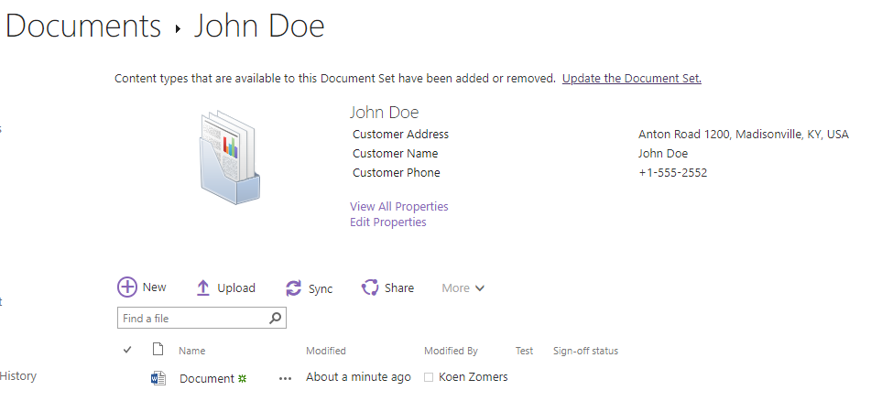
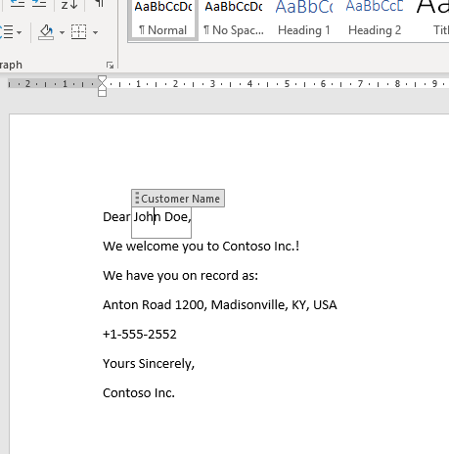

Word
Synchronize information using Document Sets and Quick Parts in Word
Microsoft Office
Notes:
The combination of Document Sets and Word can provide for a powerful way of having centralized data inside SharePoint which is automatically synchronized with your Word documents.

Slide 32
Knowledge Check
True of false: Access Apps can be used in SharePoint Online
What’s the advantage of using Document Sets in SharePoint
False. Support for Access Apps has been removed from SharePoint Online.
It allows sharing of the same metadata amongst multiple documents

Slide 33
Developer Tools
Microsoft Office
Visio, Access, InfoPath, Excel
Visual Studio 2013, 2015, 2017 and 2019
Visual Studio Code
Microsoft Azure
SharePoint Designer 2013
Notes:
Next up is Microsoft Azure

Slide 34
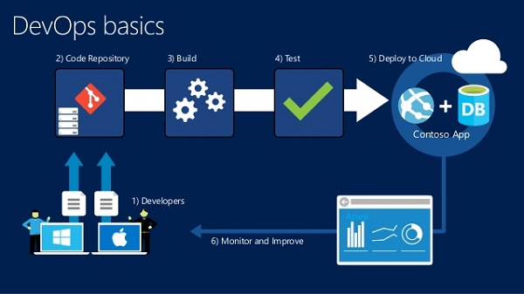
Microsoft Azure DevOps
Unlimited free private code repositories
Track bugs, work items, feedback, and more
Agile planning tools
Continuous integration builds
Develop in any language
Free for up to five users
Notes:
Formerly known as Visual Studio Online or VSTS or TFS. Microsoft Azure DevOps lets teams share code, track work, and ship software—for any language, all in a single package. It’s the perfect complement to your IDE. It is the next evolution of TFS and Team Foundation Service, bringing you the fundamentals of ALM in the cloud.
Create private team projects accessible from anywhere. Use Team Foundation Version Control (TFVC) for traditional centralized version control, or use Git if you prefer a distributed approach. You can even mix-and-match on different team projects, making it easy to host your entire organization on a single account.
Capture new features, bugs, and other work items into backlogs that are great for teams practicing Scrum, Kanban, or their own agile process. Use customizable task boards to track team progress, or use agile portfolio management for larger groups to track work across all their teams.
Catch quality issues earlier by using build definitions that automatically compile and test your applications in the cloud, either on demand or after any change in code. Track build health over time with graphs and customizable dashboards. When tests pass, automatically deploy updated web projects for SharePoint Provider Hosted Add-ins directly to Azure.
Access your projects, code, and work items through an integrated experience within Visual Studio or through a free plugin for Eclipse. Support for any Git client (including Xcode) and a modern web browser interface

Slide 35
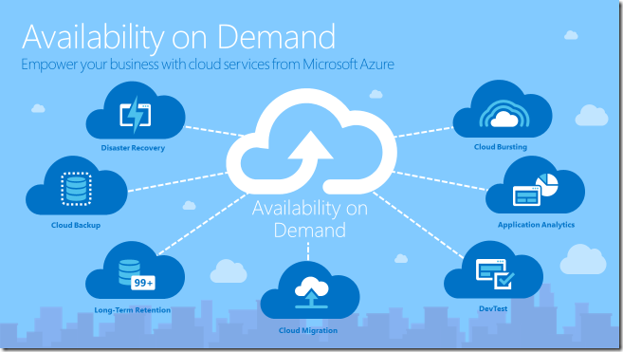
Azure Subscription
Azure provides a good environment for hosting SharePoint solutions
Development and test environments
Disaster recovery of on-premises SharePoint farms to Azure
Internet-facing sites that use features and scale not available in Office 365
Add-in farms to support on-premises environments
Host Remote Timerjobs, App Services, APIs, etc…
Notes:
Development and test environments ::
It’s easy to create and manage these environments.
Disaster recovery of on-premises SharePoint farms to Azure ::
Hosted secondary datacenter Use Azure instead of investing in a secondary datacenter in a different region.
Lower-cost disaster-recovery environments Maintain and pay for fewer resources than an on-premises disaster recovery environment. The number of resources depends on the disaster recovery environment you choose: cold standby, warm standby, or hot standby.
More elastic platform In the event of a disaster, easily scale-out your recovery SharePoint farm to meet load requirements. Scale in when you no longer need the resources.
Internet-facing sites that use features and scale not available in Office 365 ::
Focus your efforts Concentrate on building a great site rather than building infrastructure.
Take advantage of elasticity in Azure Size the farm for the demand by adding new servers, and pay only for resources you need. Dynamic machine allocation is not supported (auto scale).
Use Azure Active Directory (AD) Take advantage of Azure AD for customer accounts.
Add SharePoint functionality not available in Office 365 Add deep reporting and web analytics.
Add-In farms to support Office 365 or on-premises environments ::
Build, test, and host apps in Azure to support both on-premises and cloud environments.
Host this role in Azure instead of buying new hardware for on-premises environments.

Slide 36

Load Testing
Always Load Test your applications to see how it behaves under the anticipated load
Visual Studio Load Testing discontinued
JMeter is a free popular open source tool
Notes:
Many commercial services such as Blazemeter support running Apache JMeter tests.
Apache JMeter is a free, popular open source tool with a strong community backing. It supports many different protocols and has rich extensibility that can be leveraged to customize the tool to your needs. In addition, if you have been using Apache JMeter to run load tests using the cloud-based load testing service, you will be able to use these load tests with alternatives that support them
If you use code based tests for load testing and .NET is your platform of choice then tools such as Neoload, Micro Focus Silk Performer, and Micro Focus Load Runner are options to consider.
In addition, extensions from several load test vendors such as SOASTA (now Akamai CloudTest), Apica Loadtest, and Load Impact are available in the Azure DevOps and Azure marketplace.

Slide 37
Knowledge Check
Why is Load Testing of your applications important?
To experience how your application behaves under the anticipated load at go-live
Name a reason why you could use Azure DevOps?
Automate your deployments
Have version control
Collaborate on code

Slide 38
Lesson Summary
Many customizations can be done from a browser already
There are various tools that serve various parts of customizing SharePoint
Azure DevOps can be used to streamline your development lifecycle
Load Testing is important to experience how your application behaves under the anticipated load
Azure offers excellent features for hosting customizations
Depending on which Visual Studio version you are using, you need to take specific steps to add support for SharePoint
SharePoint Designer allows for modification of SharePoint files

Slide 39
Questions?

